Slide 1

"KajBazar" – A Local Skill Marketplace App
A Trusted Friend Nearby

Slide 2
Presented To
Presented By
Towfiq Ahmed
Lecturer
Department Of Business Administration
University Of Asia Pacific
Tamanna Sultana(22201059)
Sumayea Akter Samia(22201075)
Tanzim Tabia(22201080)
Mahinur Akther(22201100)

Slide 3
About KajBazar
KajBazar is an innovative digital platform for learning practical, daily life, and professional skills.
Offers expert-led training in Bangla, focused on real-world application and usefulness.
Helps individuals learn skills that lead to income generation and self-reliance.
Designed to be mobile-first, affordable, and accessible from anywhere in Bangladesh.
Empowers local experts to become instructors and earn by sharing their knowledge.
Aims to bridge the opportunity gap in skill-based learning across urban and rural communities.

Slide 4
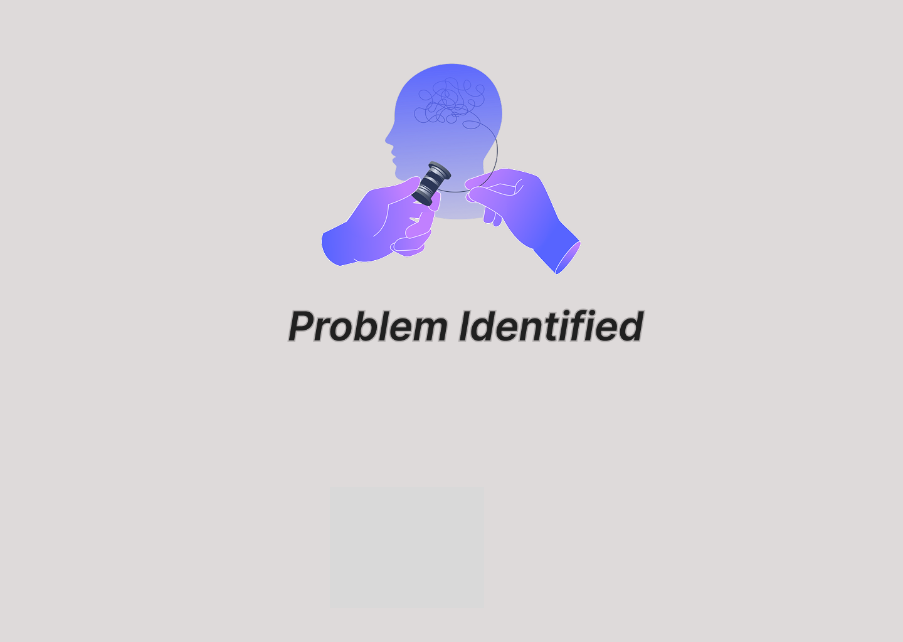

Slide 5
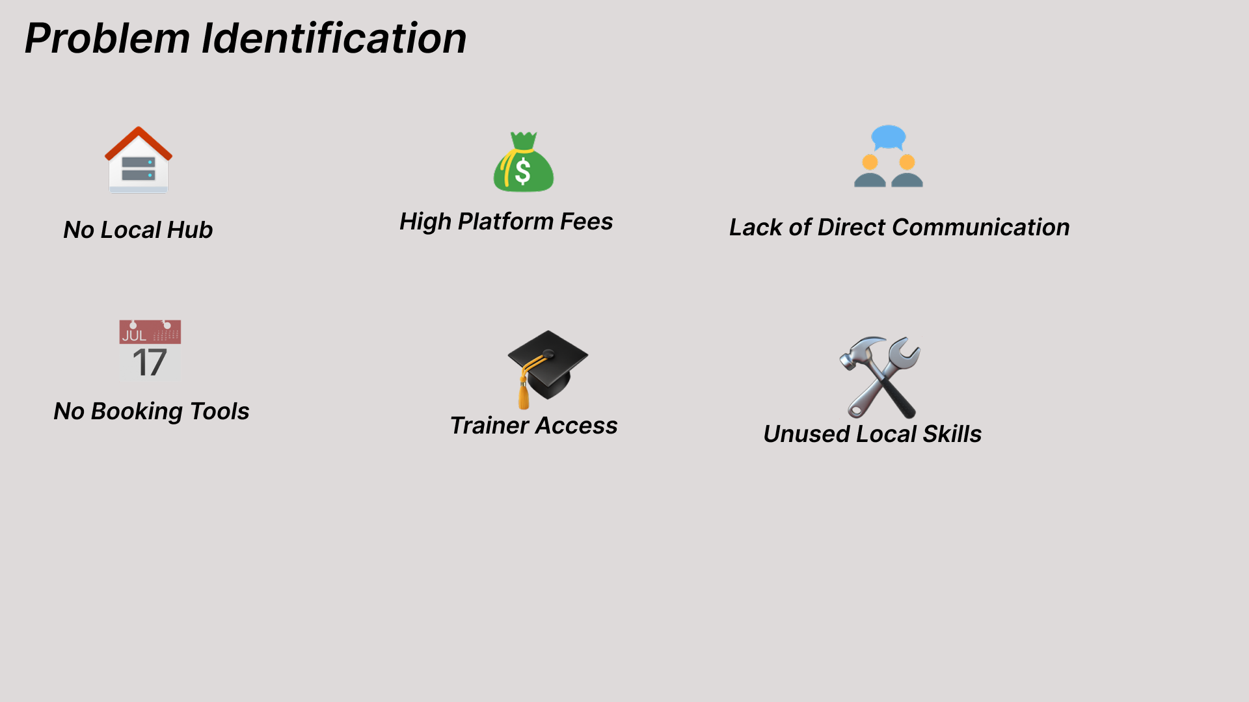

Slide 6
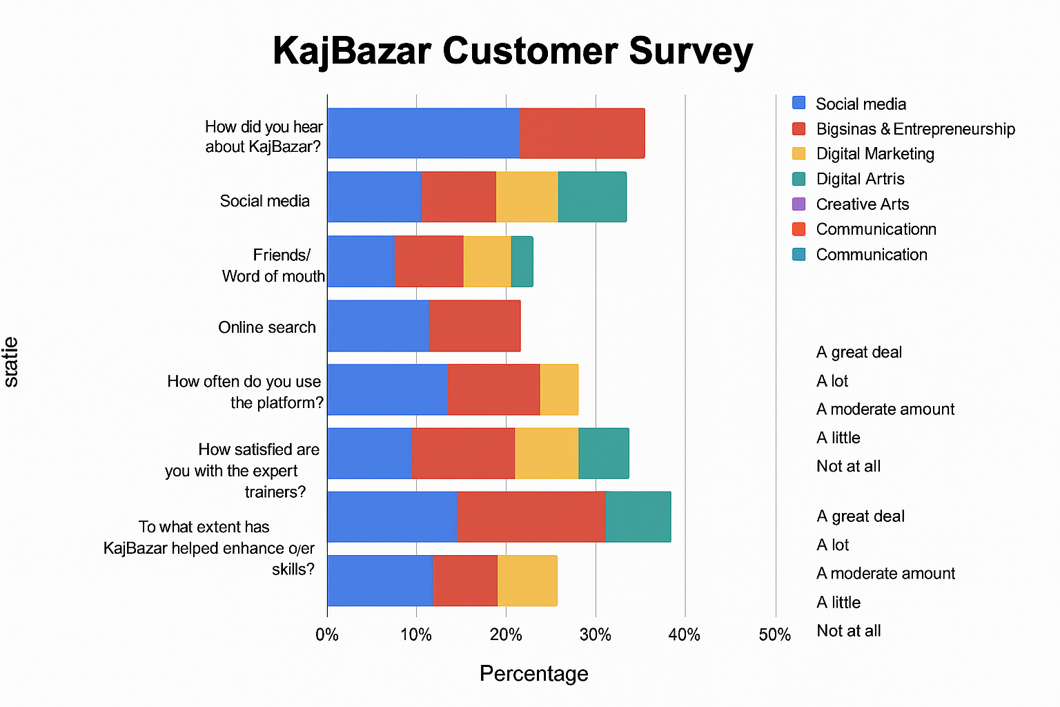

Slide 7
📊 KajBazar – PESTEL Analysis
Factor | Key Insight | Impact Level
Political | 65% of developing countries have national skilling missions; government partnerships possible | 🔵 Moderate
Economic | Youth unemployment at 12–25% in many regions; high demand for low-cost upskilling | 🟢 High
Social | 70% of housewives and non-working adults' express interest in home-based earning opportunities | 🟢 High
Technological | Mobile-first approach works well: 88% mobile internet penetration in target areas | 🟢 High
Environmental | Online training cuts travel/resource costs by ~80% vs. physical centers; sustainable footprint | 🟢 Positive
Legal | Must comply with data privacy laws (GDPR/local laws) and contracts for placement commissions | 🔵 Moderate

Slide 8


Slide 9
Opportunity Gap
63% of people rely on agencies or local trainers
91% of users say current learning options are:
Too expensive
Inflexible
Not practical or locally relevant

Slide 10


Slide 11
Our Solution
- Paid online and offline courses taught by verified trainers.
- High-quality, practical skill-building programs.
- Direct connection between skilled learners and trainers.
- Mobile-first platform accessible nationwide.
Platform for experts to teach & earn
Affordable & Inclusive Access

Slide 12


Slide 13
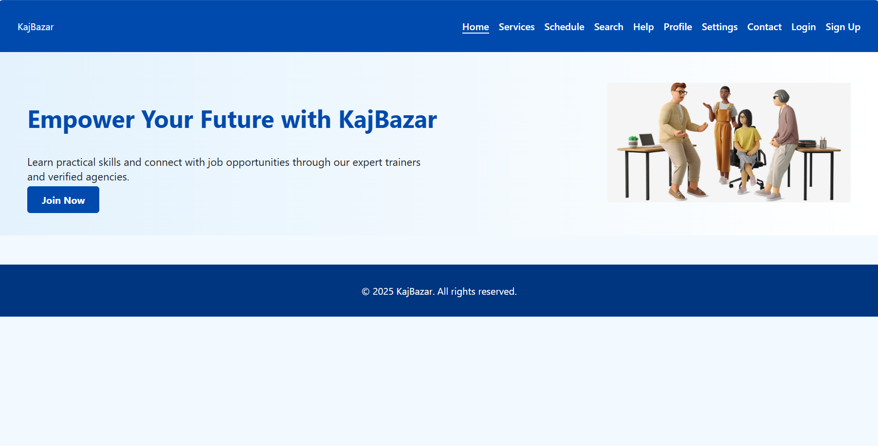


Slide 14
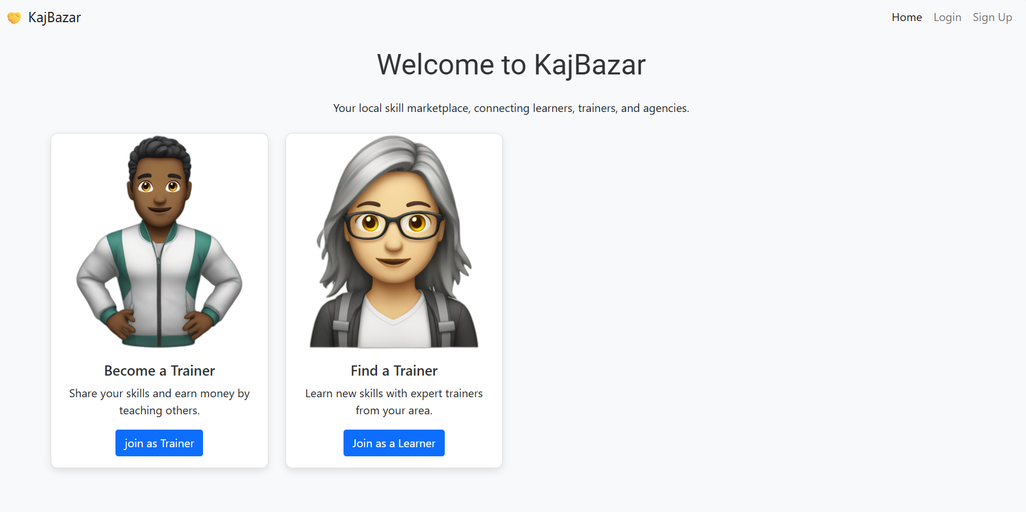

Slide 15
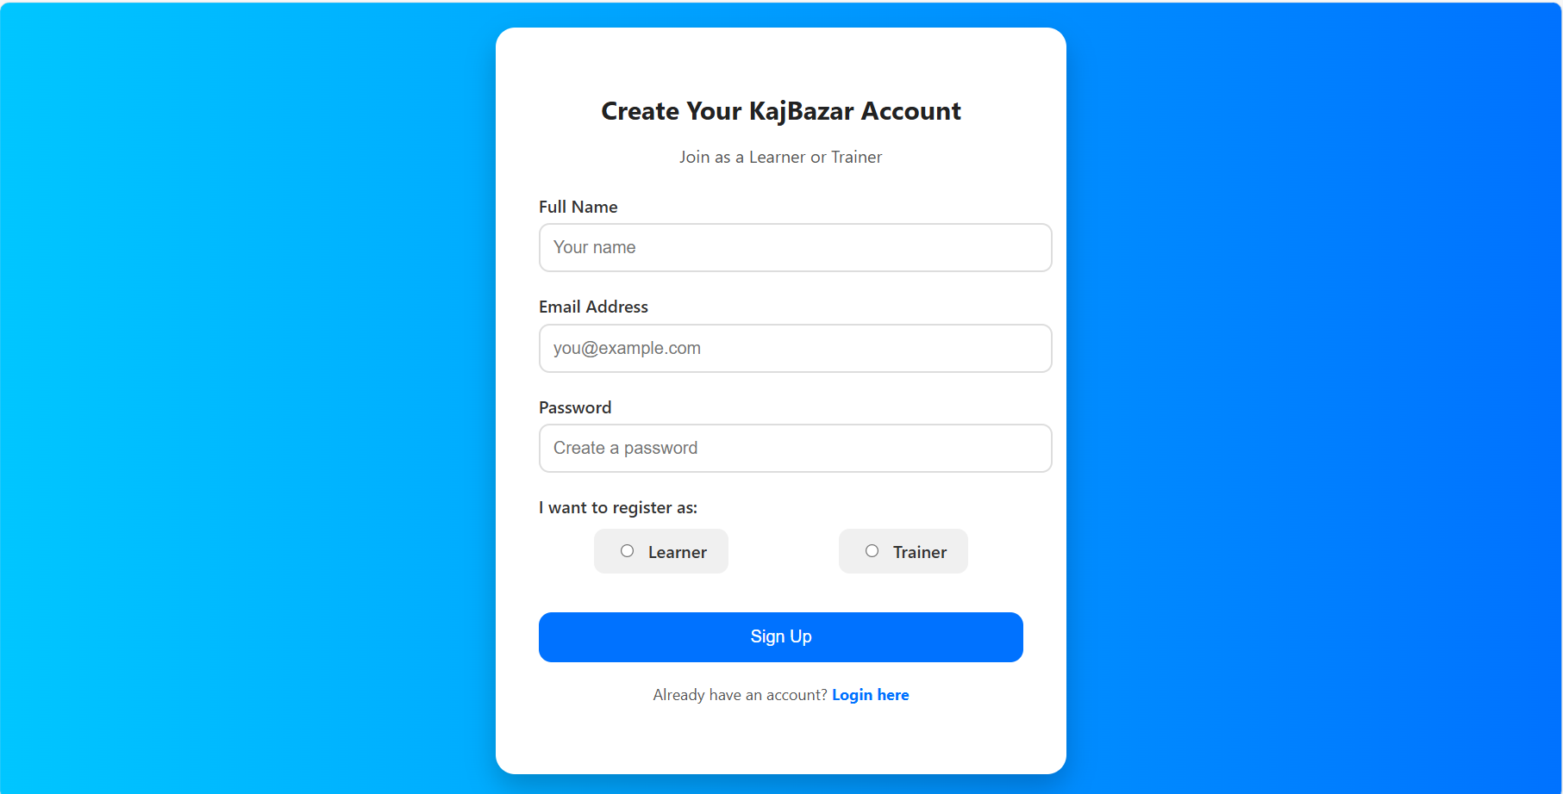

Slide 16
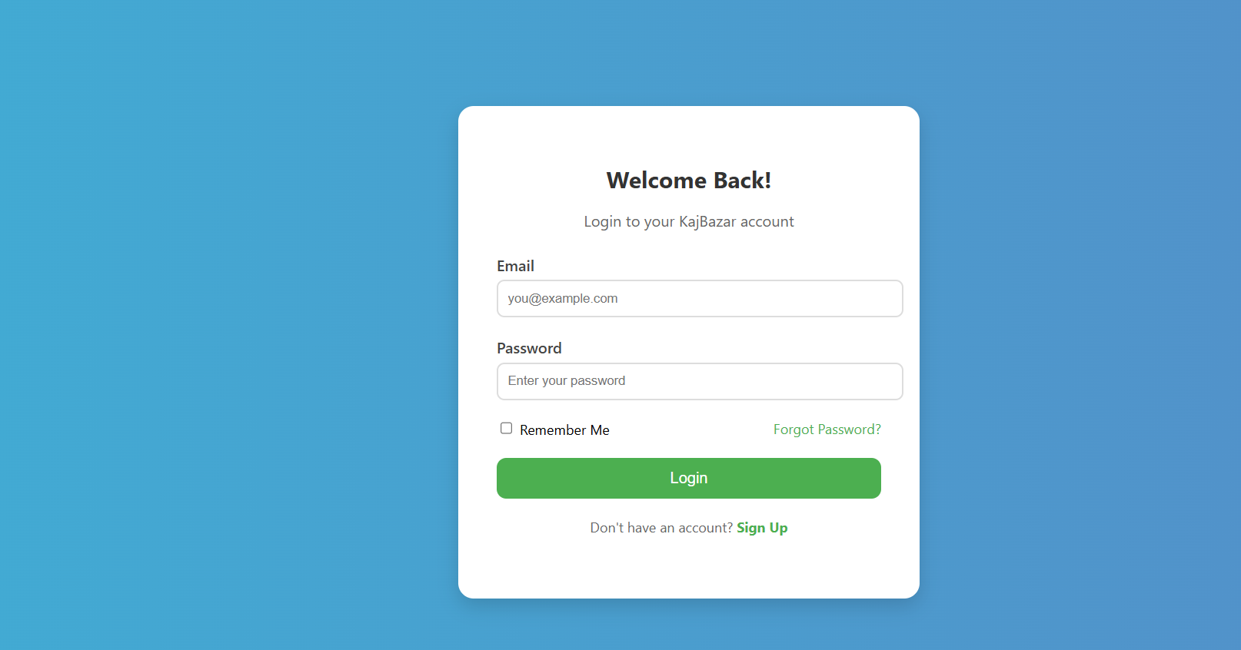

Slide 17
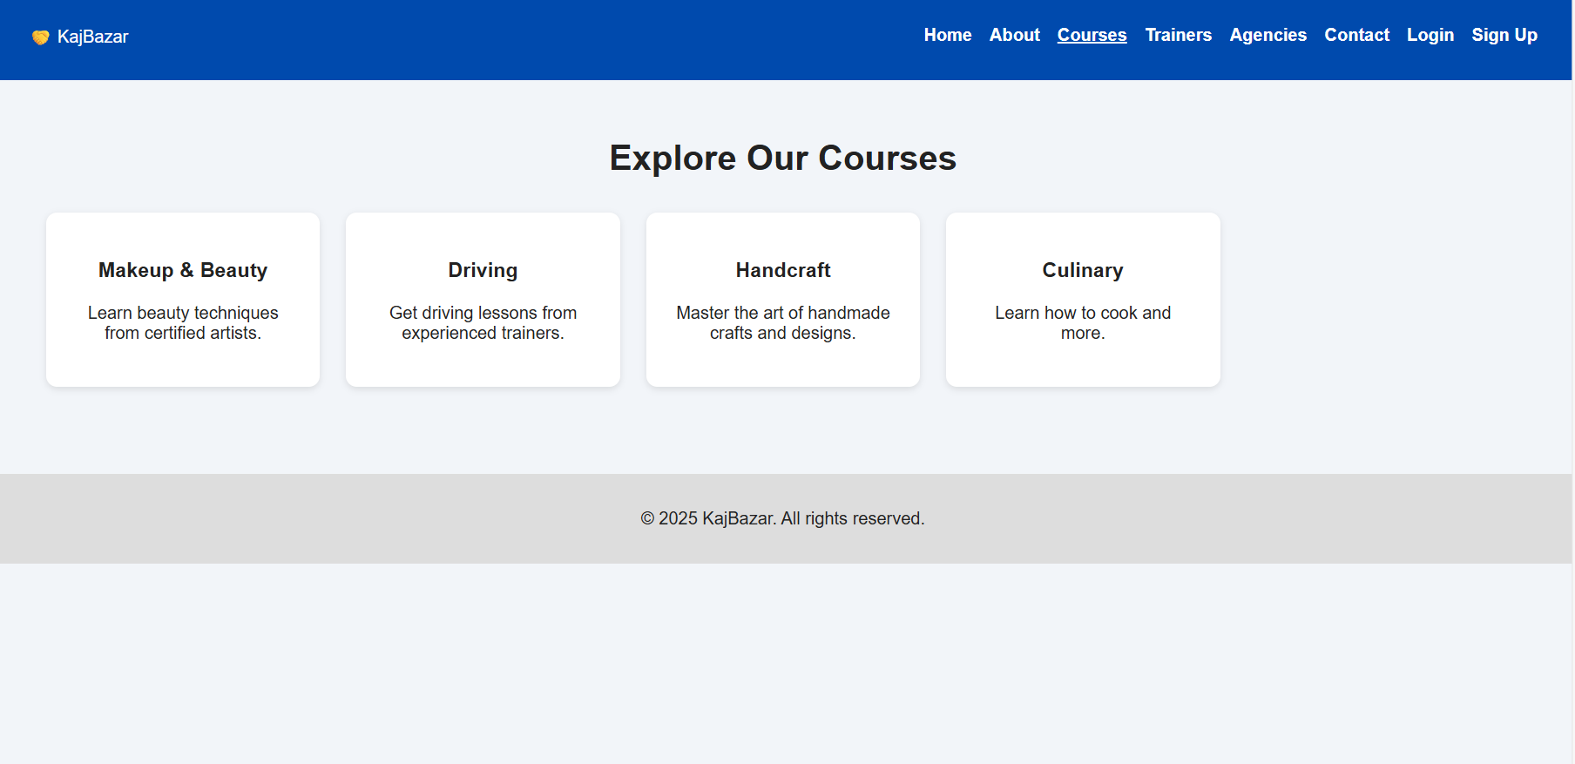

Slide 18
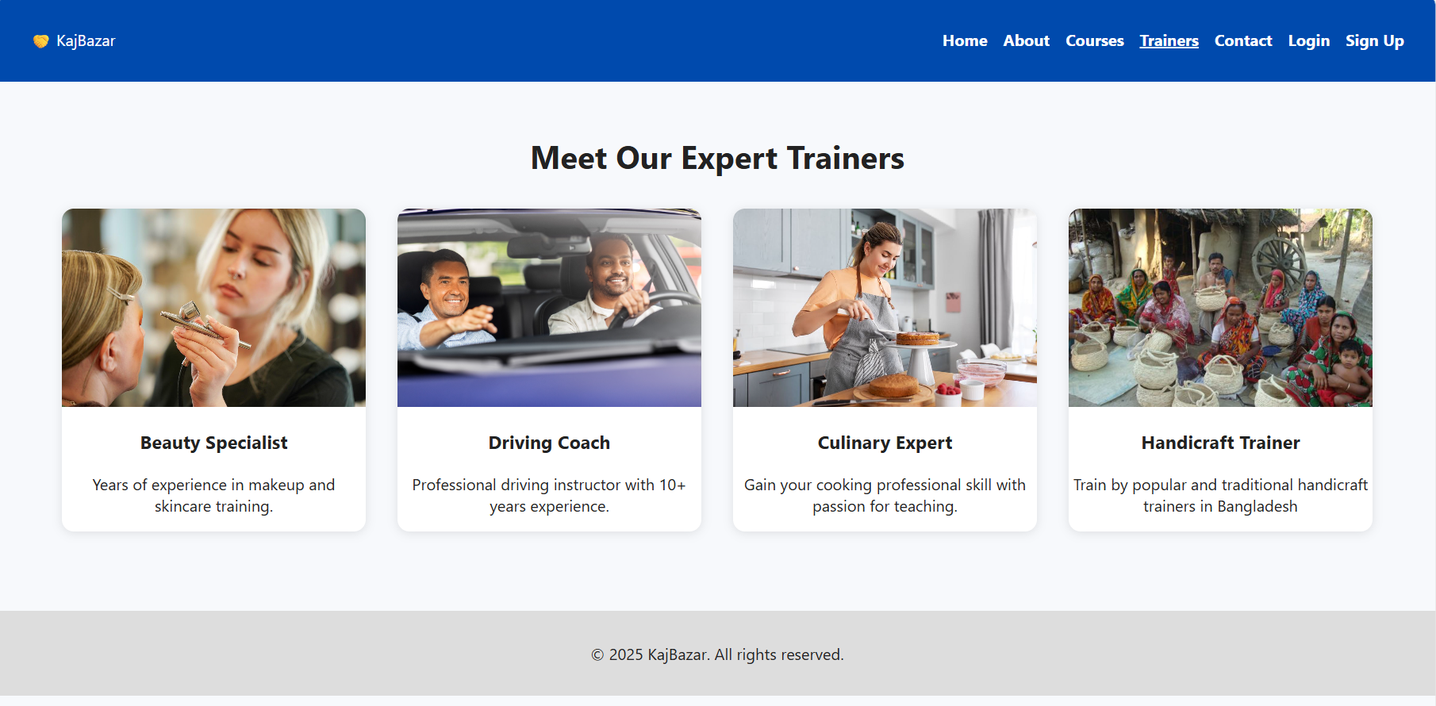

Slide 19
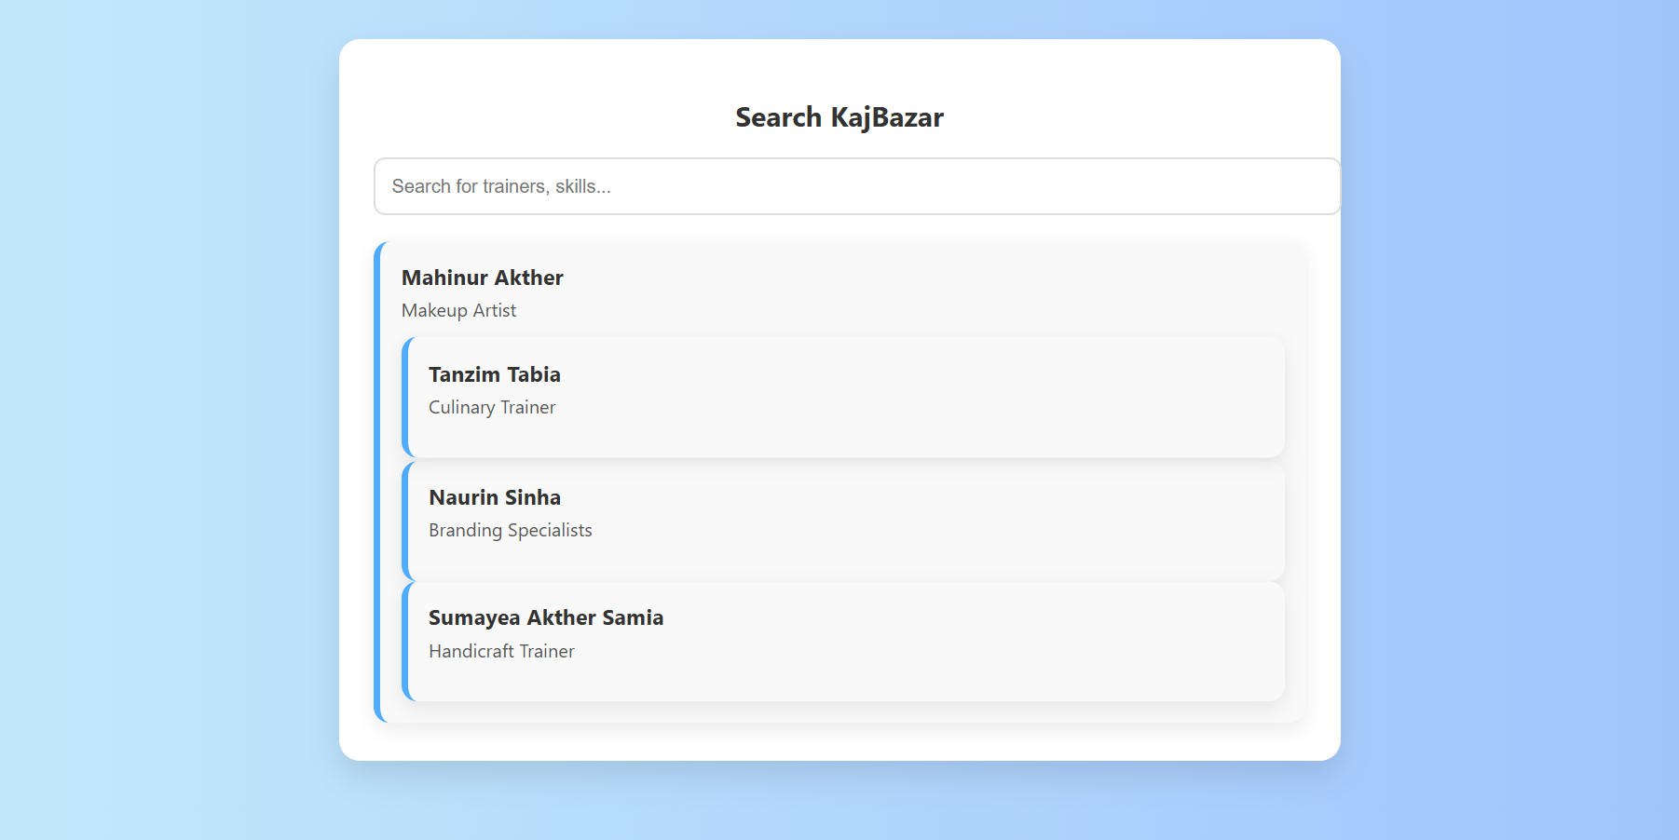

Slide 20
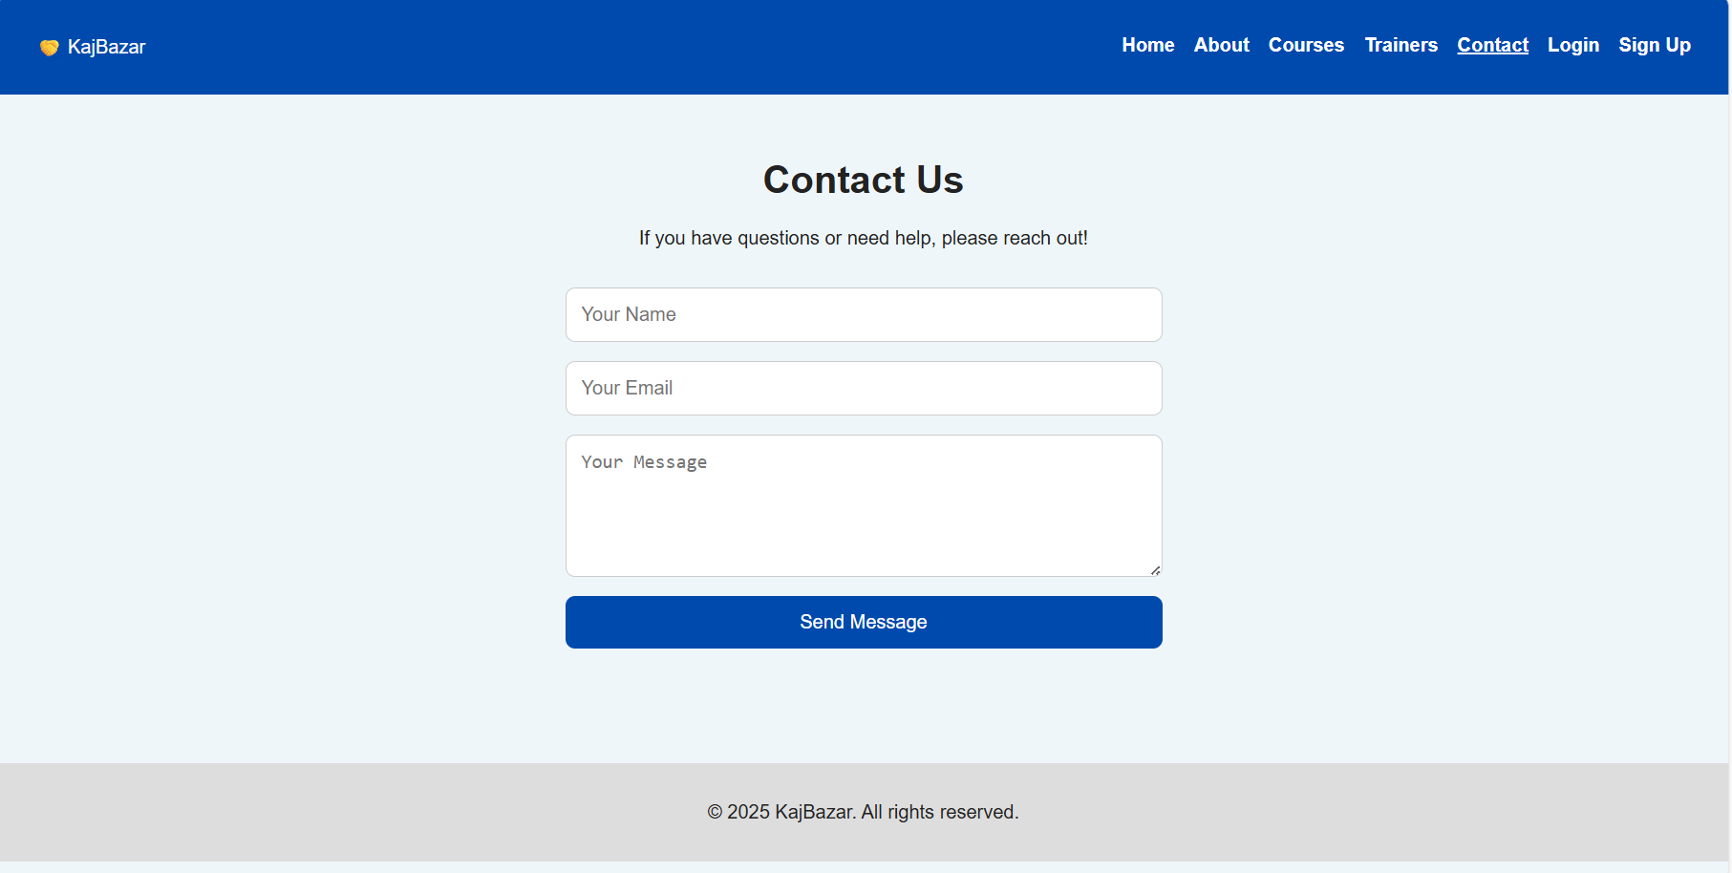

Slide 21
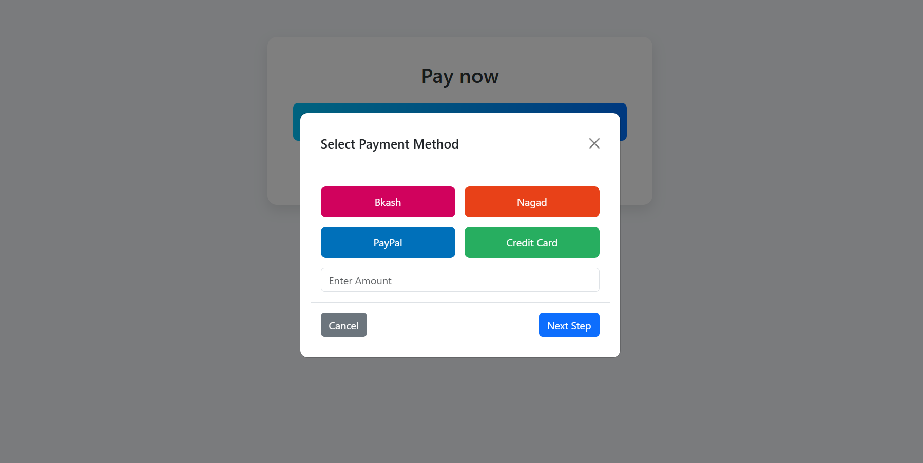

Slide 22
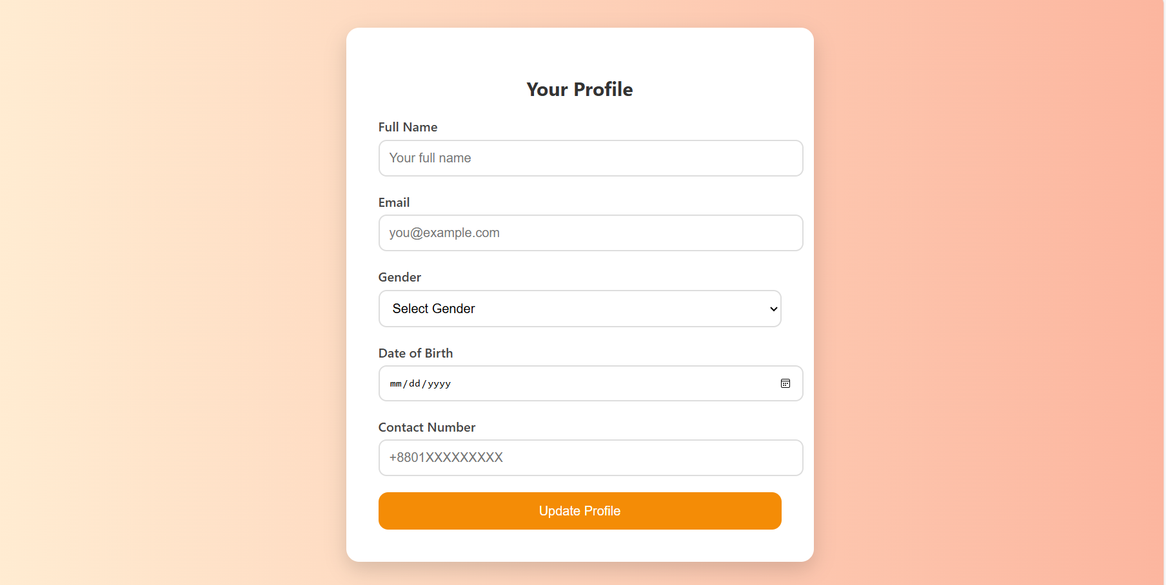

Slide 23
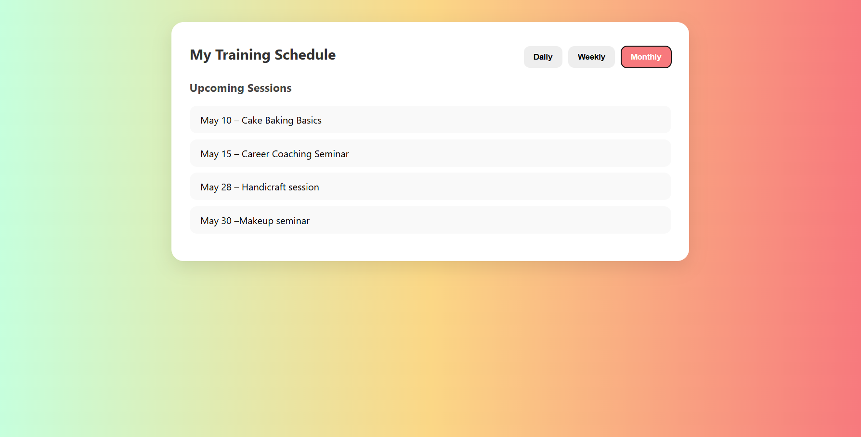

Slide 24
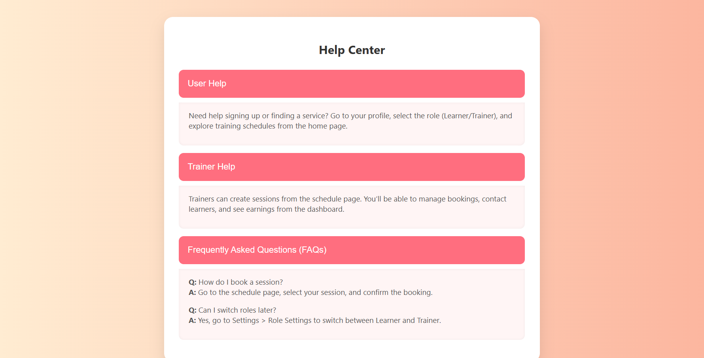

Slide 25
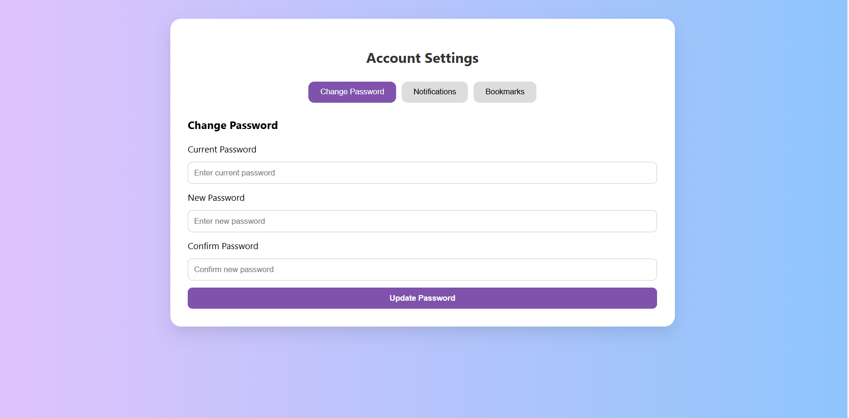

Slide 26
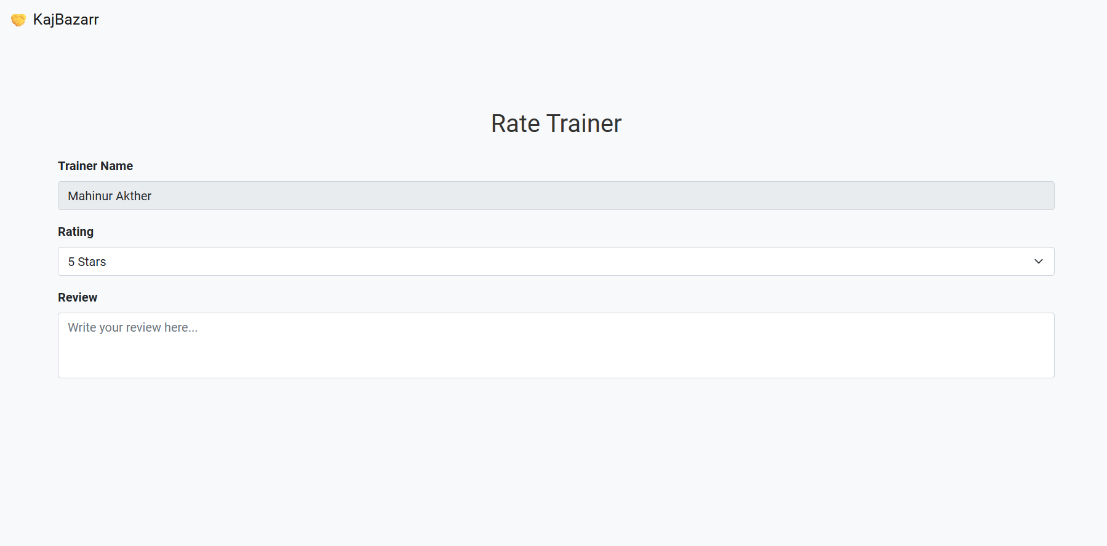

Slide 27
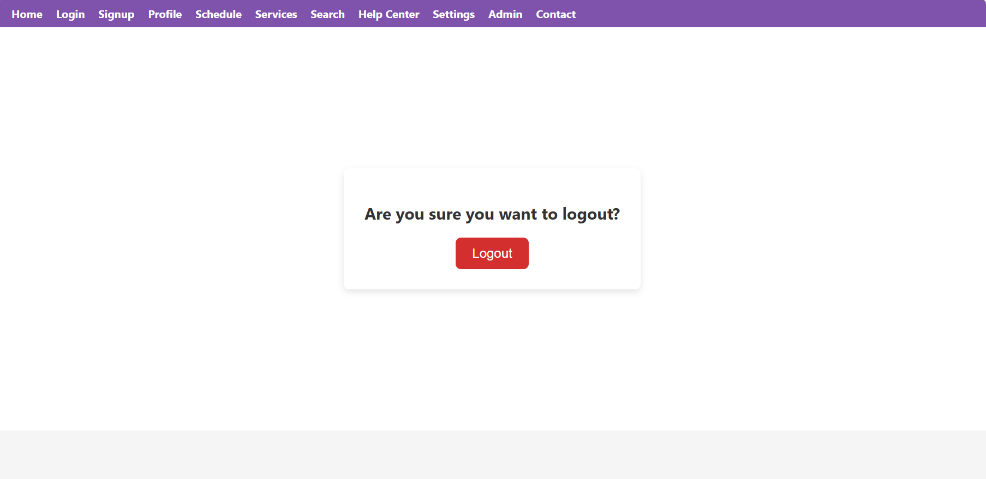

Slide 28


Slide 29
💰 Our Launch Budget: BDT 30 Lakh
Category | Budget (৳)
Platform Development | 900,000
Marketing & Outreach | 600,000
Trainer Acquisition & Content | 450,000
Staffing & Operations | 600,000
Legal & Contingency | 450,000
Total | 3,000,000

Slide 30
CUSTOMER CONNECTION:
How We Connect | What We Do
Easy Start | Simple signup steps with a quick welcome video and course suggestions.
Regular Updates | Send email, SMS, WhatsApp, and app alerts about new courses and reminders.
Community Chats | Create group chats and forums where learners can ask questions and share tips.
Live Q&A | Host regular live sessions where trainers answer questions in real time.
Rewards & Badges | Give discounts for referrals and badges for active learners.
Feedback Loop | Short surveys after courses and occasional feedback workshops.

Slide 31
Originality and Value Proposition of the IDEA
1.Effectively communicates features of the product/service: KajBazar is an innovative online platform designed to bridge the gap between people seeking practical skills and trainers with real-world expertise.
Skill-Based Live Learning Learners can choose from a wide range of practical skills—such as graphic design, coding, digital marketing, and more—and get trained directly by professionals.
Trainer Discovery and Profiles Each trainer has a detailed profile with ratings, reviews, skills, and sample work, helping learners make informed decisions.
Booking and Scheduling System Users can book one-on-one or group sessions with trainers at flexible times through an easy-to-use calendar and session management interface.

Slide 32
2.Unique Selling Proposition (USP) & Innovation:
KajBazar is the first Bangladeshi platform that connects learners with verified local trainers for live, one-on-one skill sessions, payable via bKash/Nagad. It offers personalized, real-time learning in Bangla, focusing on job-ready skills — not academic theory or passive video content. Unlike traditional platforms, KajBazar is affordable, interactive, and built for the local context, making it truly innovative and hard to replicate. Unlike video-based platforms, it offers affordable, interactive learning tailored to local needs — making it unique and hard to copy.

Slide 33
3. Cannot Be Easily Imitated:
KajBazar’s localized approach—using Bangla, bKash/Nagad payments, and trust-based trainer verification—creates a barrier that international platforms can’t easily cross. Its live, micro-learning model and regional trainer ecosystem are built on cultural insight, not just technology.
4. Solves a Problem:
Millions of Bangladeshi youths lack access to practical, income-generating skills. KajBazar directly connects them with affordable, real-time learning that leads to freelancing and job opportunities.

Slide 34
Market and Competition Analysis :
Market Size Bangladesh has over 45 million youths aged 15–35, with high unemployment and growing demand for online skill-based learning. The South Asian e-learning and freelancing market is projected to exceed $10 billion by 2026.
Competition Global platforms like Udemy, Coursera, and YouTube offer recorded content but lack Bangla language, local payment support, and real-time interaction.
Potential Customer Group Target users include students, fresh graduates, job seekers, freelancers, and homemakers seeking to learn practical skills for income generation.

Slide 35
Business Model :
Critical Risks Identified
Quality Control: Risk of unqualified trainers affecting learner trust (solution: verification, reviews, moderation).
Payment Disputes: Risk of fraud or dissatisfaction (solution: escrow system and dispute resolution support).
Trainer and Learner Retention: Risk of user churn (solution: loyalty rewards, gamification, community engagement).
Internet Access Limitations: Especially in rural areas (solution: audio-only or low-bandwidth options).

Slide 36
Business Model :
Pricing of the Product/Service KajBazar uses a pay-per-session model, where learners pay between 100–300 BDT per live session, depending on the trainer's expertise and session length. KajBazar takes a 15–25% commission from each transaction. Future options include subscription plans and premium group workshops.
Distribution Process KajBazar is distributed primarily through its mobile app and website, supported by digital marketing campaigns on platforms like Facebook, TikTok, and YouTube.

Slide 37
Financial Planning & Forecasting:
Financial Feasibility
KajBazar is financially feasible due to its low operating costs, digital-first model, and transaction-based revenue stream. The platform generates income from each session booked, taking a 15–25% commission—ensuring revenue from day one. Since content is created and delivered by independent trainers, there's no upfront cost for course development, which significantly reduces capital requirements.
Additionally, the use of automated systems for trainer onboarding, scheduling, and payment handling minimizes ongoing operational costs, making the business model lean and sustainable

Slide 38
Financial Planning & Forecasting:
KajBazar is designed to scale rapidly with minimal fixed costs. Here's a simplified forecast:
Year | Total Users | Paying Learners | Recruiters | Revenue (৳) | Estimated Costs (৳) | Net Profit/Loss (৳)
1 | 5,000 | 300 | 20 | 400,000 | 800,000 (setup phase) | -400,000
2 | 15,000 | 1,000 | 50 | 2 million | 2.3 million | -300,000
3 | 30,000 | 3,000 | 120 | 6 million | 5.5 million | 500,000
4 | 60,000 | 7,000 | 250 | 14 million | 12 million | 2 million
5 | 100,000 | 15,000 | 500 | 30 million | 25 million | 5 million

Slide 39
Customer Acquisition Cost (CAC) :
is the average amount you spend to acquire one new customer. It’s a key metric for understanding the efficiency of marketing and sales efforts.
Customer Type | CAC (৳)
Paying Learners | 600
Recruiters | 12,000
Blended Average | 571
Calculated as:
Learners → 600 = 600,000 ÷ 1,000
Recruiters → 12,000 = 600,000 ÷ 50
Blended → 571 ≈ 600,000 ÷ 1,050

Slide 40
MARKET SIZE:
Below is an overview of KajBazar’s addressable market in Bangladesh, broken into Total Addressable Market (TAM), Serviceable Available Market (SAM) and Serviceable Obtainable Market (SOM):
Market | Size (USD) | Size (BDT) | Assumption
TAM | $16 billion | ৳1.6 trillion* | Entire Bangladesh EdTech market today
SAM | ≈ $3.2 billion | ৳320 billion | ~20 % of TAM (practical upskilling & placement)
SOM | ≈ $32 million | ৳3.2 billion | ~1 % of SAM (realistic 5‑year foothold)

Slide 41
Target Market
- Youths seeking jobs
- Housewives aiming for income sources
- Students wanting to learn practical skills
- Unemployed individuals needing quick career starts

Slide 42
🌟 What Makes KajBazar Unique?
• Real-Time Skill Transfer – Unlike pre-recorded videos, learners engage in direct interaction with trainers.
• Empowerment Through Earning – Trainers, especially in developing regions, can earn by sharing their expertise online
• Hyperlocal Focus – Tailored to the Bangladeshi and South Asian audience with culturally relevant content and payment solutions.
Job-Oriented, Not Just Knowledge-Oriented-Focus on teaching skills that lead to income opportunities, design Low-Cost and On-Demand Learning:Learners can book short sessions (30 mins, 1 hour) instead of paying for expensive full courses.

Slide 43
Why Choose KajBazar?
- Professional, Verified Trainers
- Real-world Skill Building
- Job Placement Assistance
- Affordable and Flexible Learning
Our Motive:
Learn, Earn, Succeed

Slide 44
Conclusion:
KajBazar offers a complete journey: Learn skills, connect with job providers, and start earning.
We empower individuals to build better futures, boost self-reliance, and create sustainable income sources.
Together, we build a skilled nation.

Slide 45
Thank You
Let's Grow Skills. Let's Grow Futures.

Slide 46
Any question ???

